Slide 1
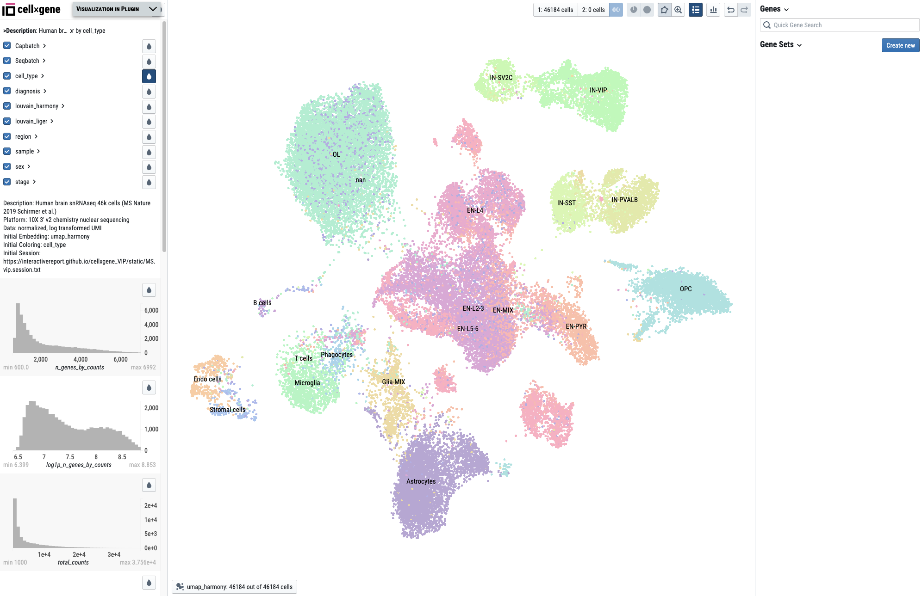
Clip all continuous values to a percentile range
Click the button to save the current selection as cell group 1
Subset to selected cells & associated metadata
Show labels of categorial annotation
Click the down-arrow to bring VIP window up
Undo/Redo
Search a gene
Group 2
Get top 10 DEGs between group 1 and group 2
Select embedding
Drag to pan, scroll to zoom
Show all cells & associated metadata
Create a gene set
Categorical annotations
Project description
The list of histograms to show distribution of continuous variable
Main visualization panel
Select embedding method

Slide 2
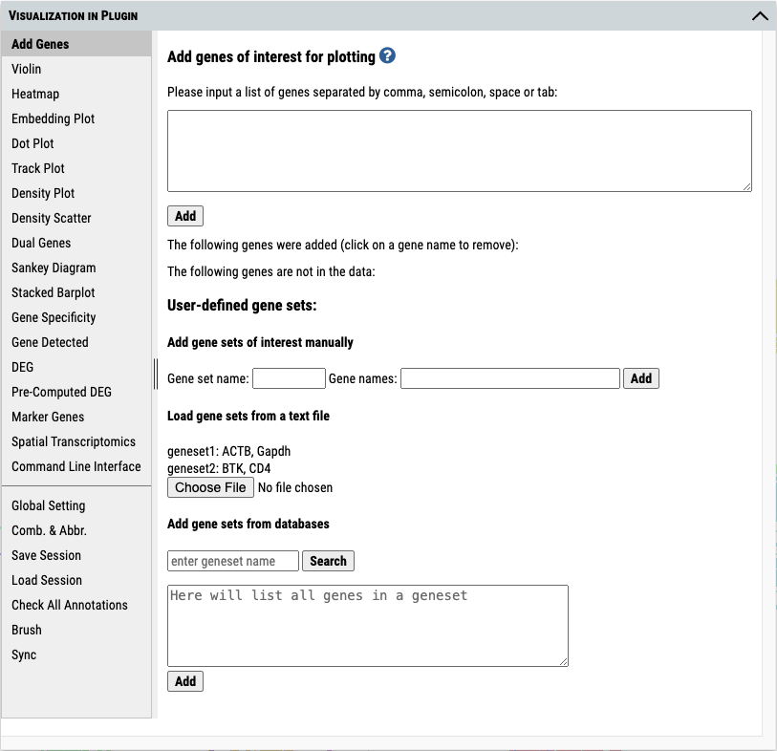
Press the header and drag to move the window.
Click to minimize to original location
function menu
Press and drag to change the menu width.
Press any corner and drag to change the window size.

Slide 3
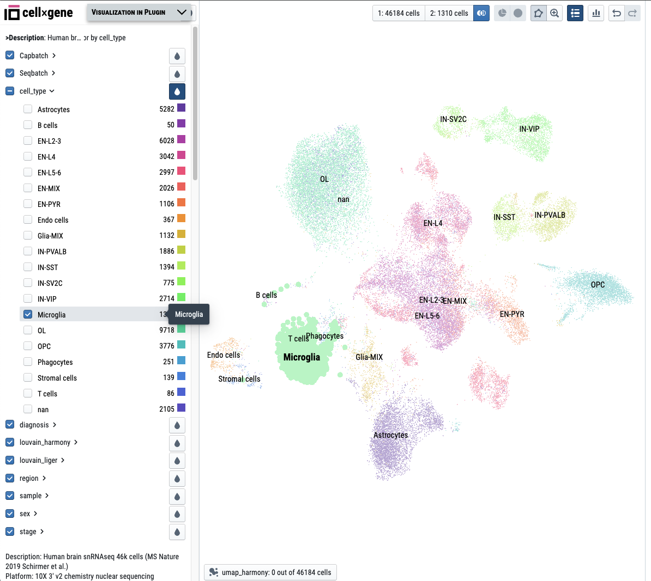
Click to view the number of selected cells and save cell selection into the group
Use as color scale
Select/unselect all categories of an annotation
Selected category is highlighted by the assigned color
Check to select a category

Slide 4
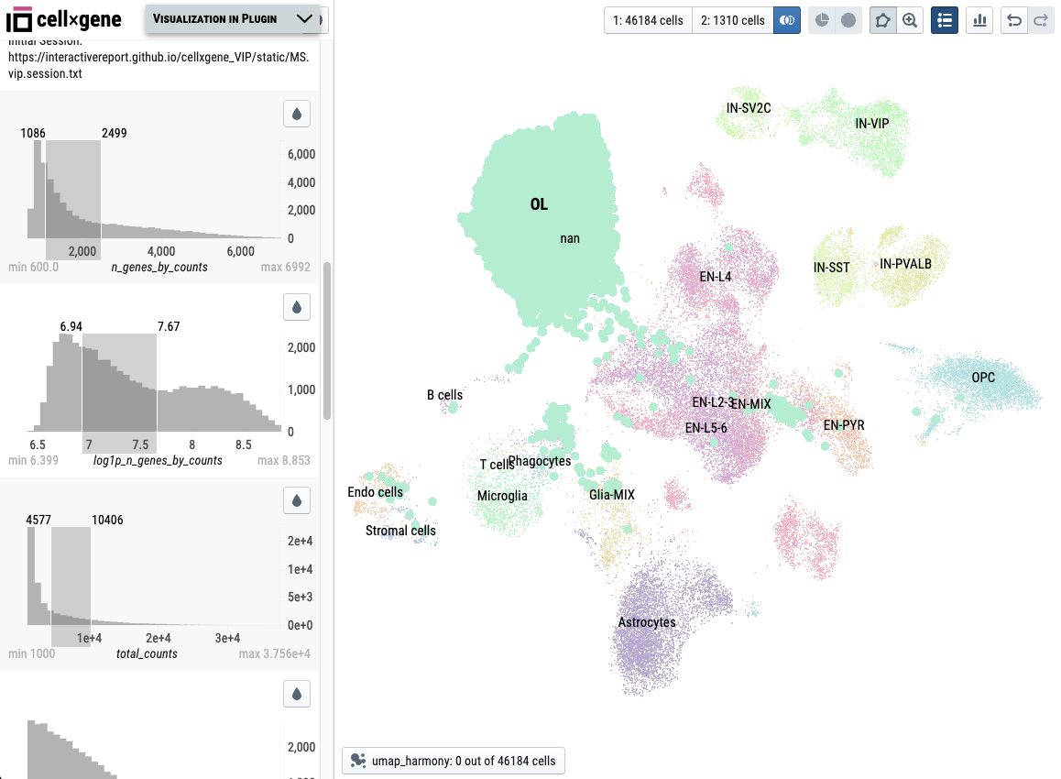
Brush to select cells by gene count
Brush to select cells by normalized gene count
Brush to select cells by total count

Slide 5
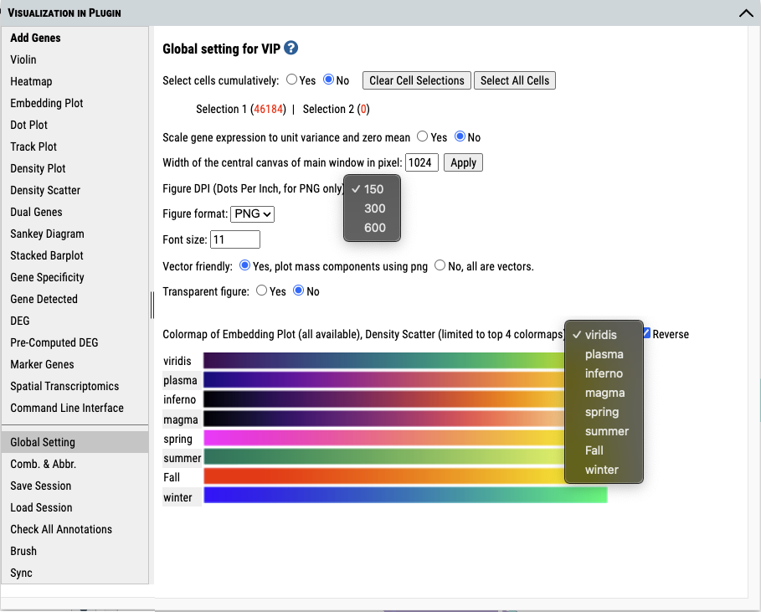
Set figure resolution
Set figure format: PNG or SVG
Set font size in figure.
Set colormap
Click to change global setting for VIP

Slide 6
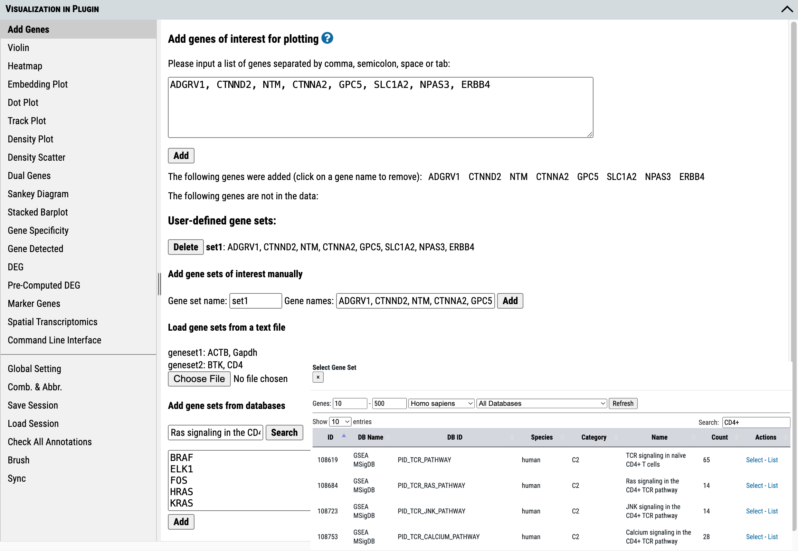
Add the above list of genes for plotting
Add the list of genes as the user-definded gene set for plotting
Load multiple gene sets by uploading txt file contain the gene set list in the format provided.
Opened databases search window.
Keyword search
Add the list of genes from databases using searching function.
Select to add

Slide 7
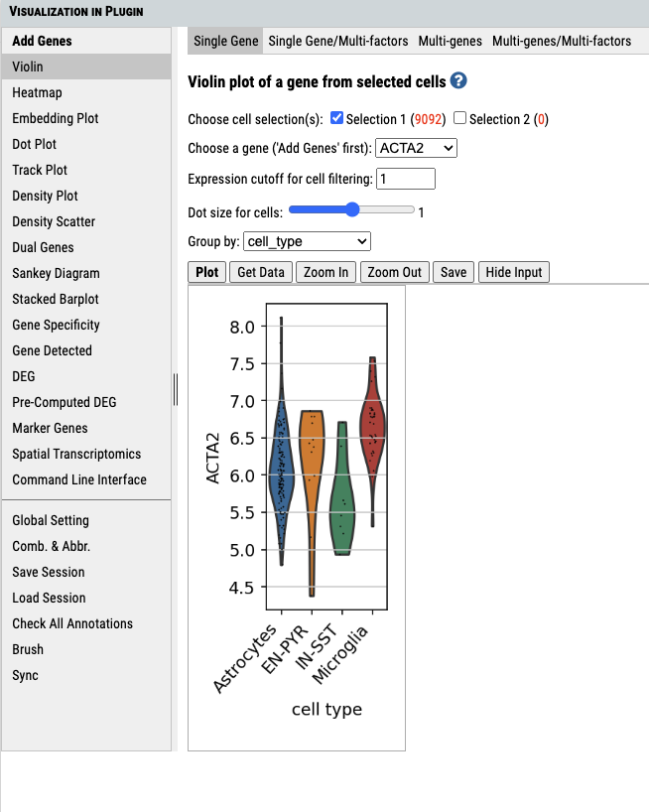
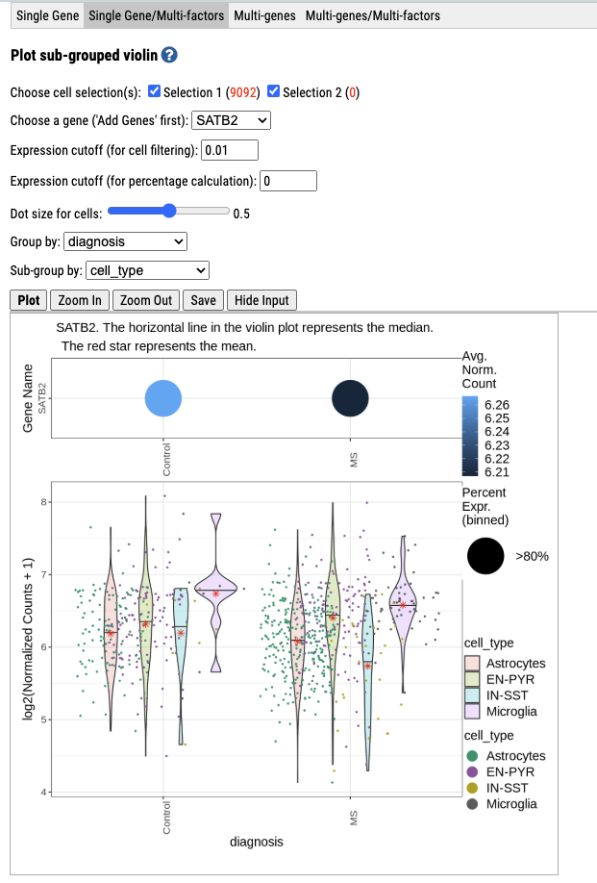
1.Select group(s) of cells for plotting.
2.Select added gene and cells by the expression cutoff
3.Group cells by cell_type for plotting
4. Plot it
Nested basic violin plot by the selected subgroup category
Download data
Save plot
Hide input section to get more space for plot

Slide 8
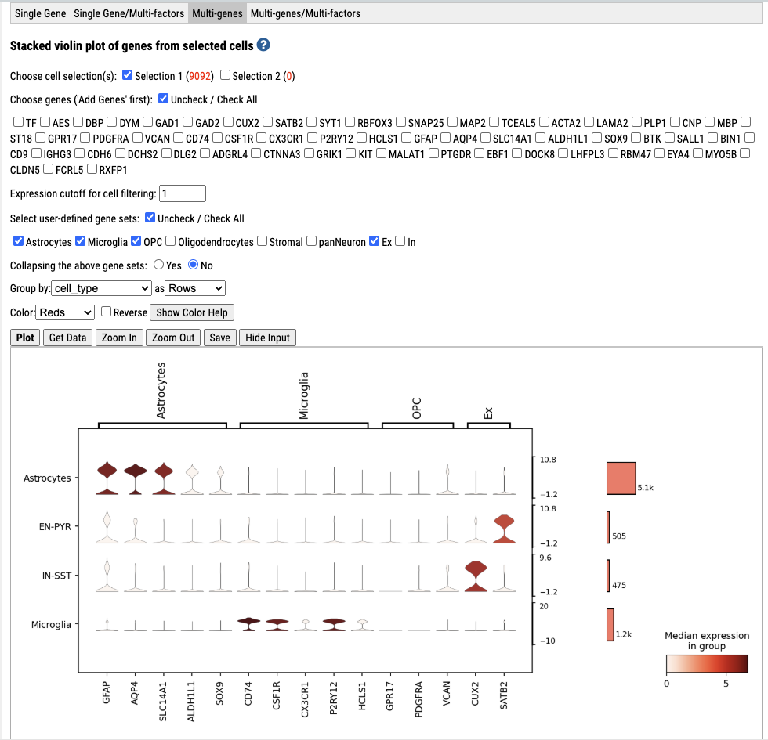
1.Select group(s) of cells for plotting.
2. select multiple added genes
3. And/Or select gene set(s)
4. If using gene sets, select collapse gene set or not.
5. Group cells by annotation and set orientation.
6. Plot it
Number of cells passing expression cutoff
Cell_type
Selected genes

Slide 9
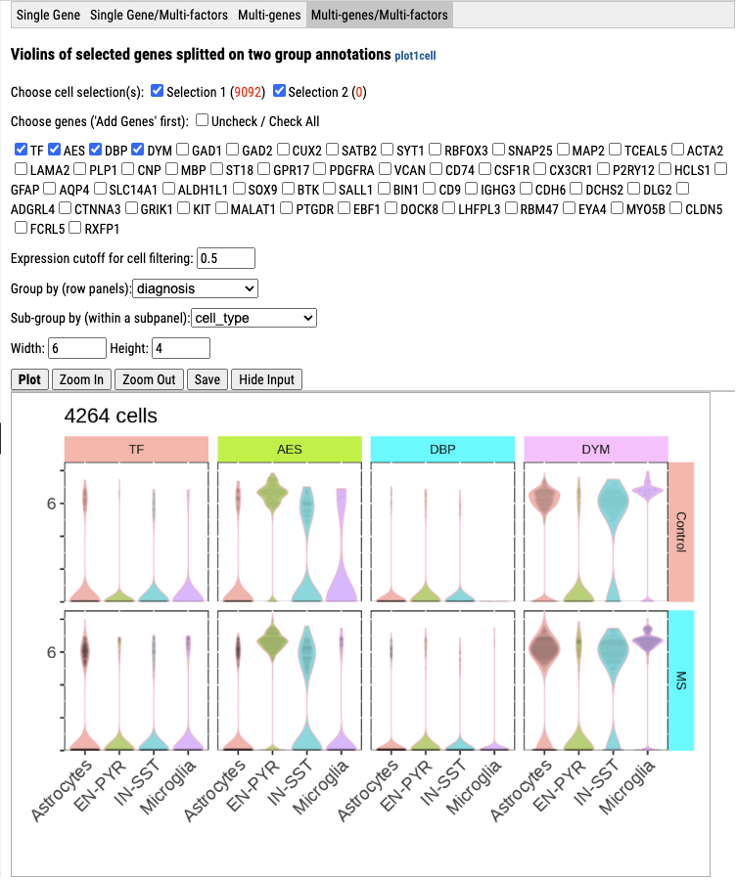
Nested basic violin plot by the selected subgroup category
gene list
diagnosis group
Cell_type

Slide 10
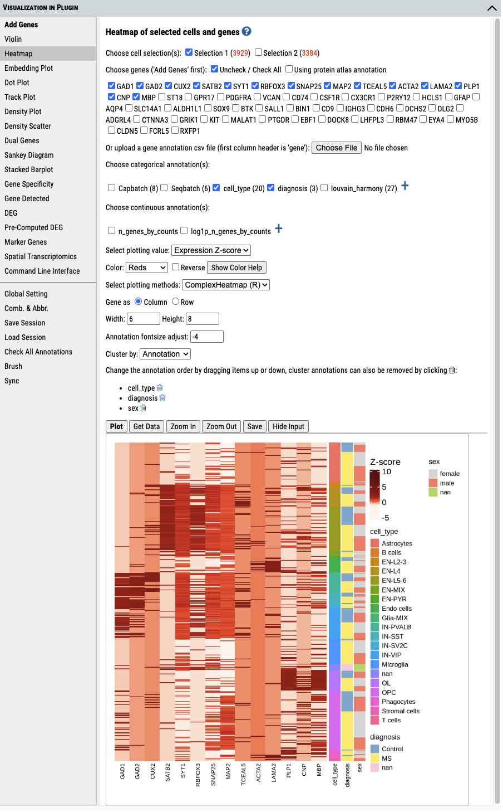
1.Select group(s) of cells for plotting.
2.Select multiple added genes. If need annotation, select protein atlas annotation or uploading annotation file.
3. Select categories for annotation in plot.
Click “+” to see full list of annotation categories
4. Plot preference setup.
5. Select cluster category and customize the order.
6. Plot it

Slide 11
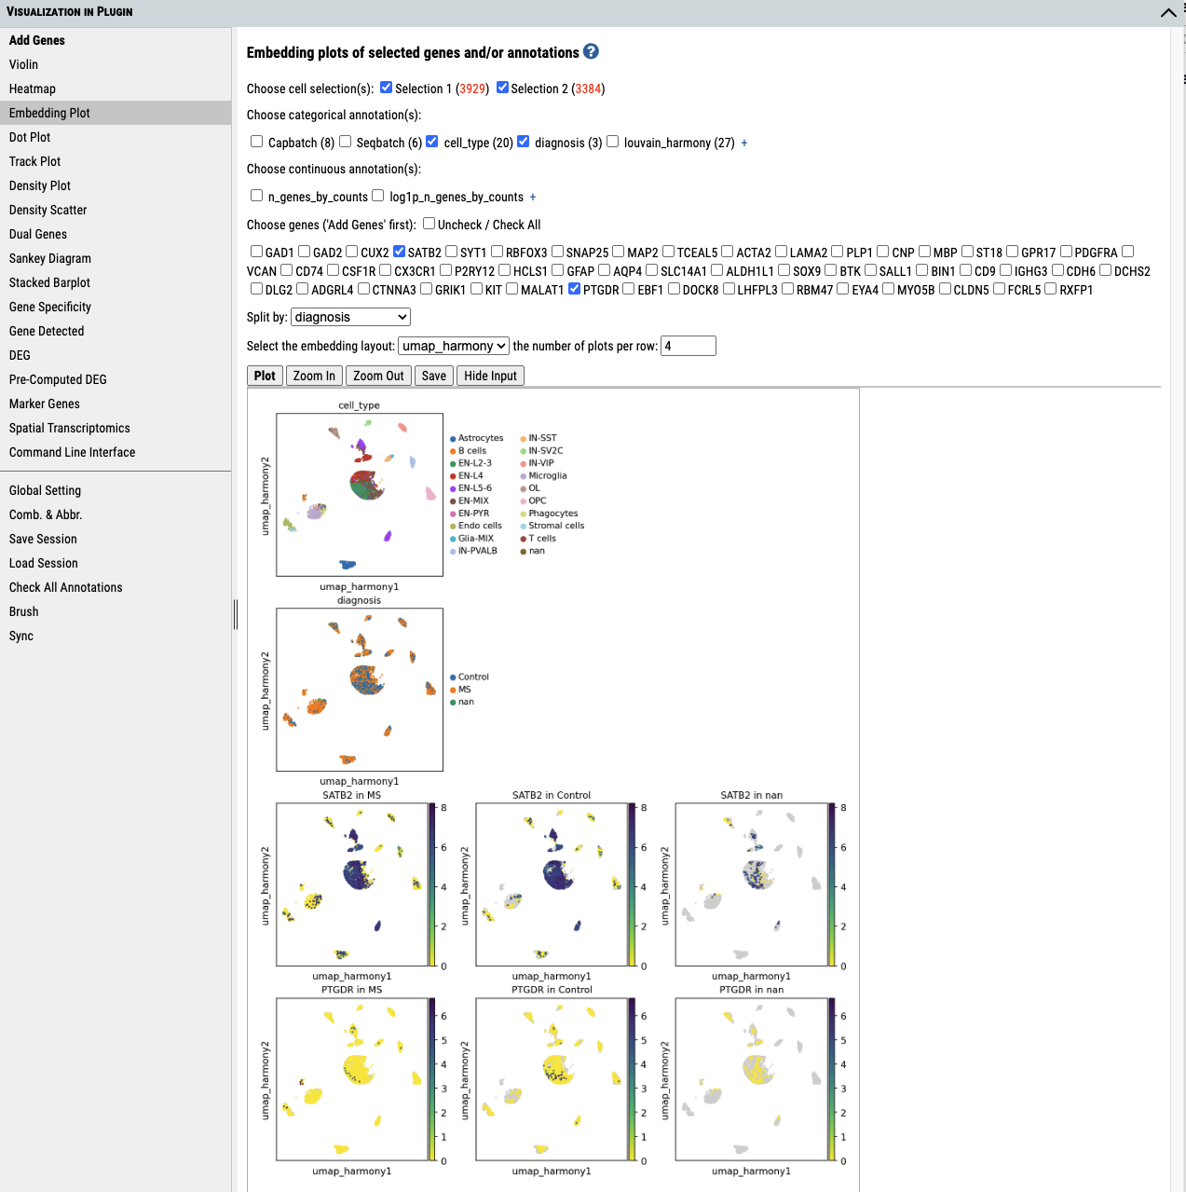
1.Select group(s) of cells for plotting.
2. Select categories to annotate. Click “+” to view full list of annotation categories
3.Select genes.
4. Select splitting category.
6. Plot it
5. Select embedding type.

Slide 12
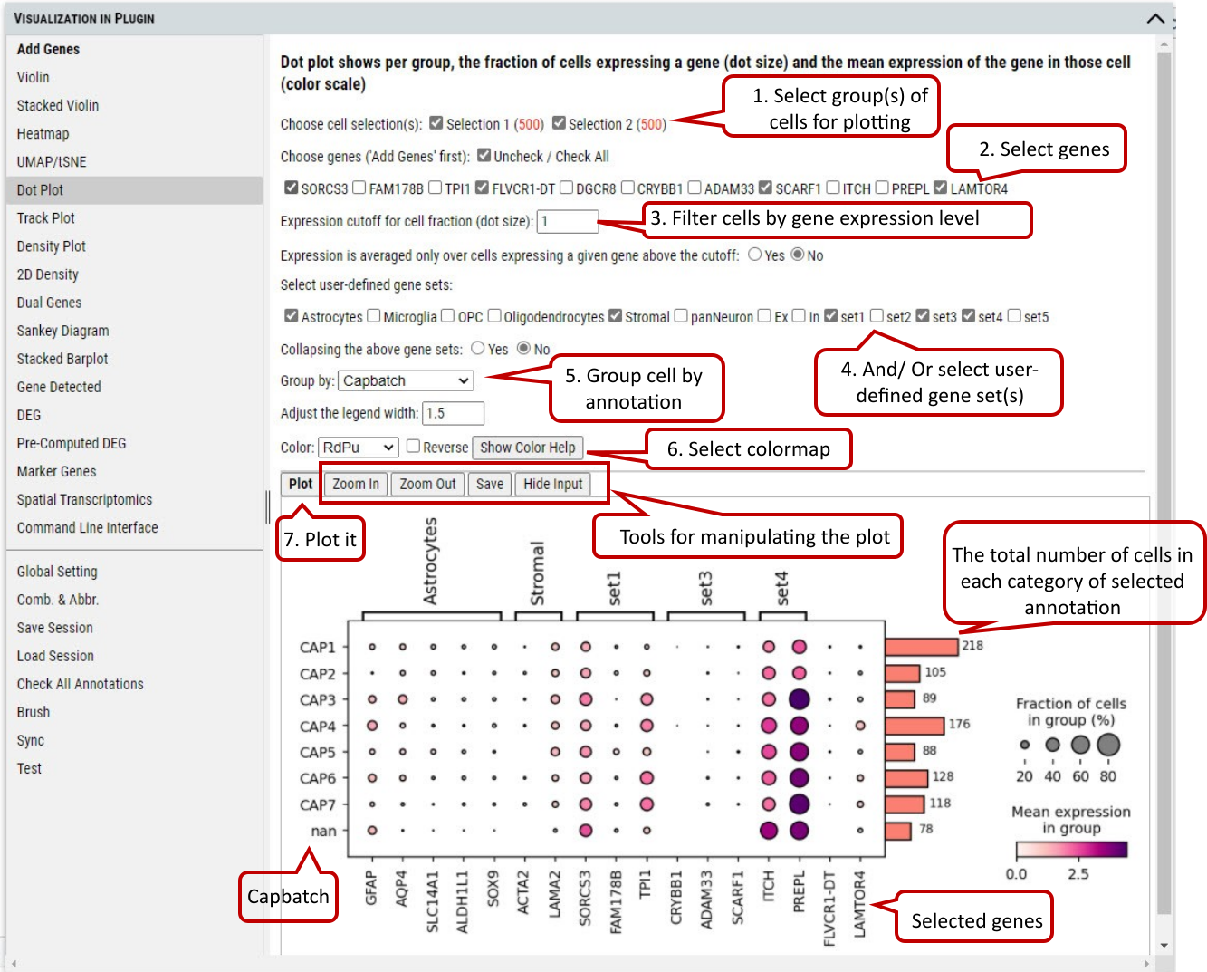

Slide 13
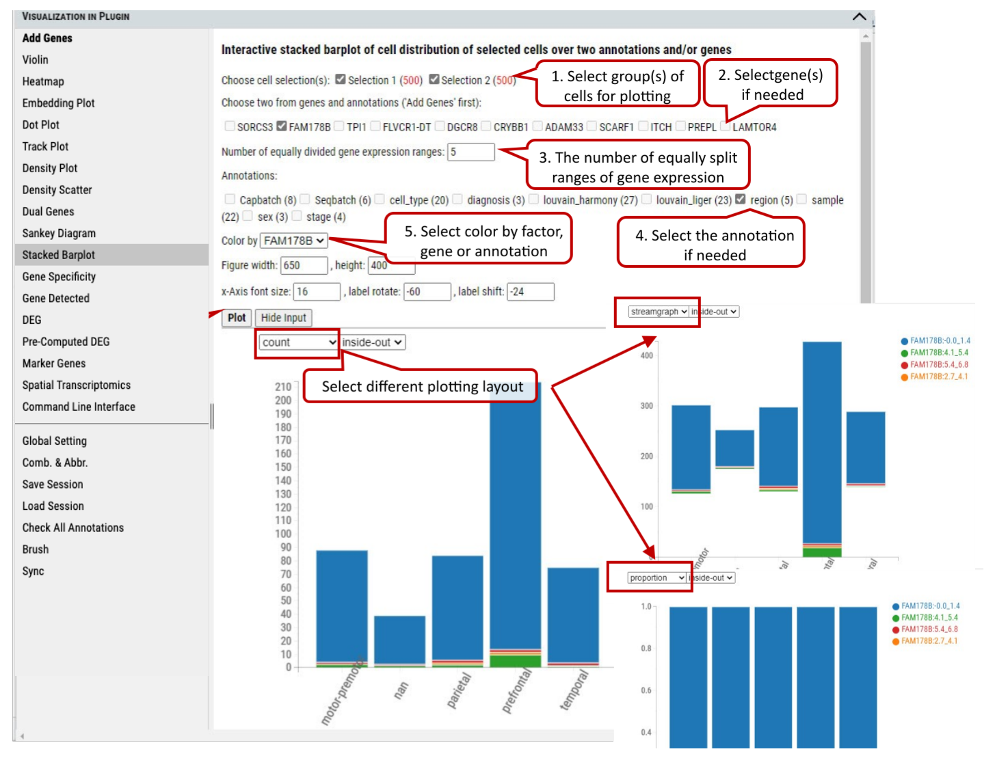
6. Plot it

Slide 14
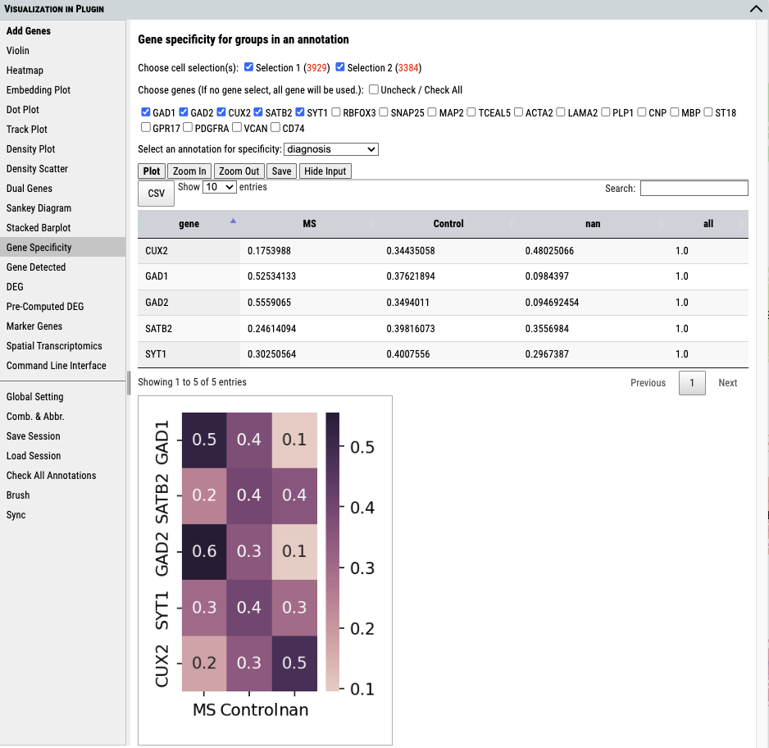
1.Select group(s) of cells for plotting.
2.Select genes.
3.Select annotation category.
4.Click to plot.
Result data table
Result plot

Slide 15
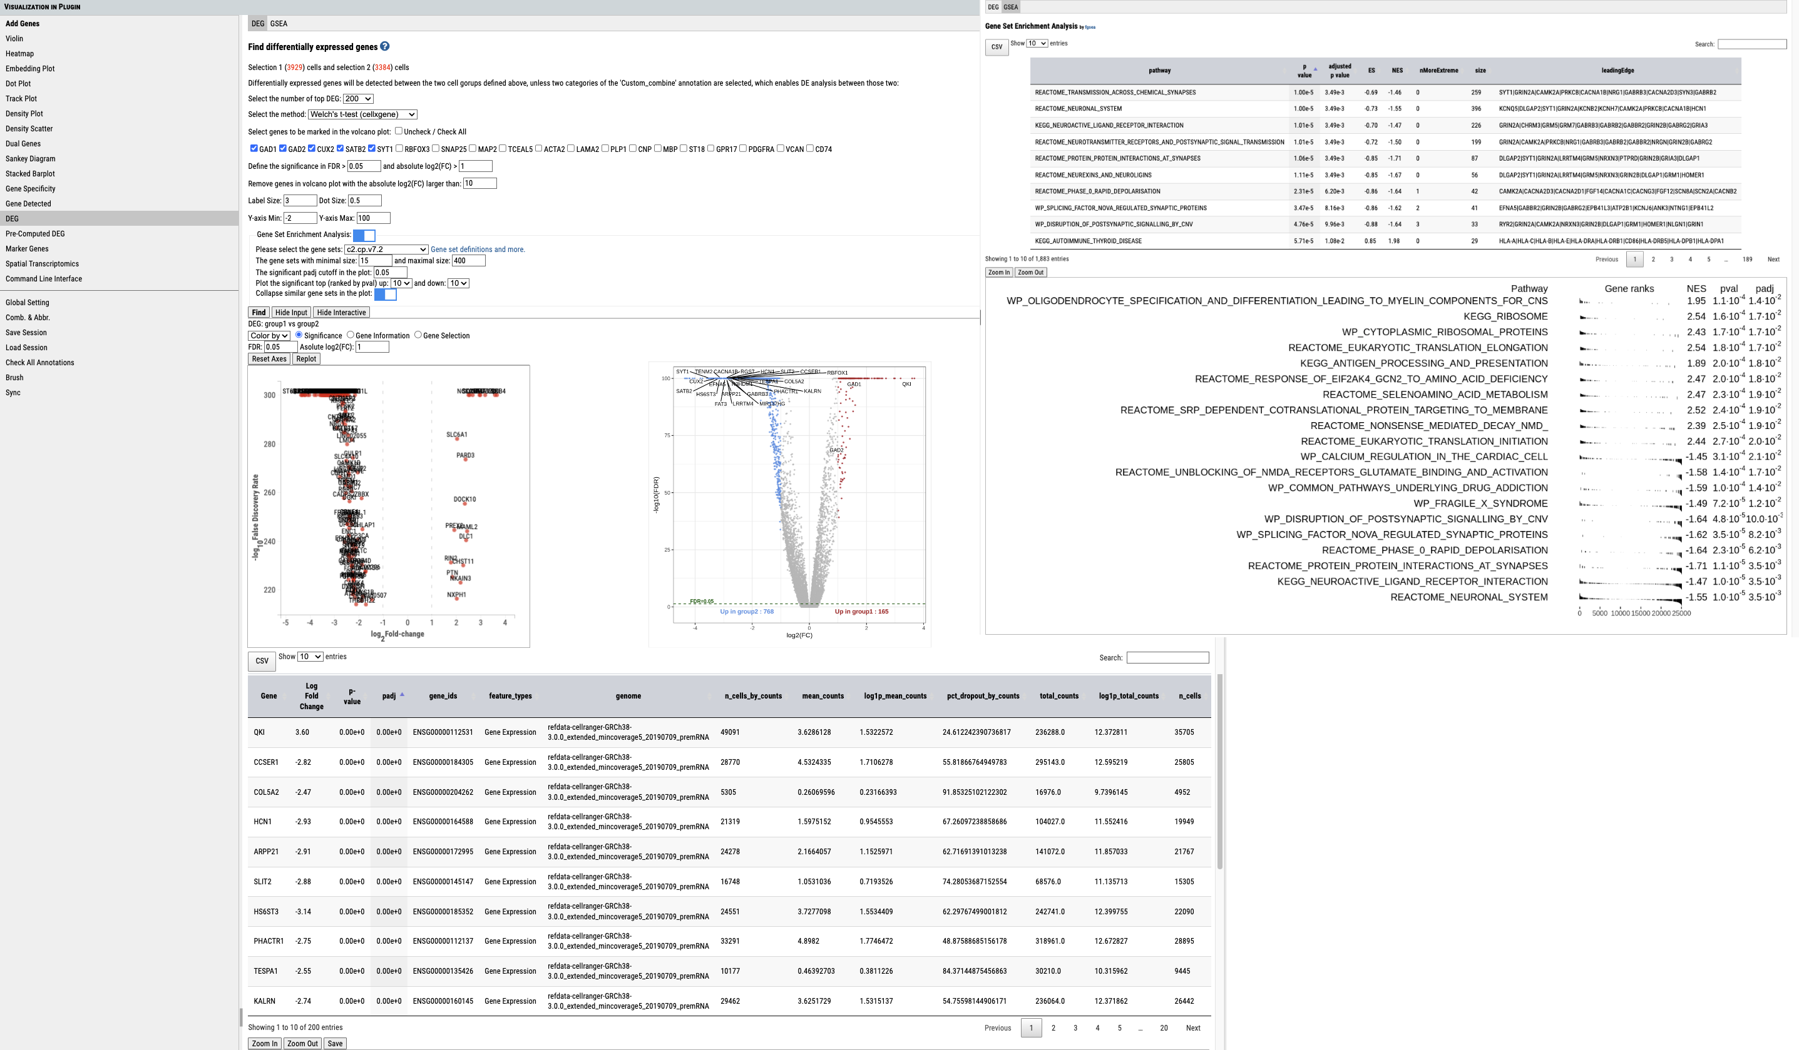
1.Select group(s) of cells for plotting.
GSEA result table
3. Select statistical method
2. Top DEGs to be listed in the result table
4. Select gene(s) to be labeled in static volcano plot.
GSEA analysis preference setup. Results are shown in the second tab.
Static volcano plot with selected genes
Enrichment plot of the selected top enriched gene sets
Interactive volcano plot
Result data table

Slide 16
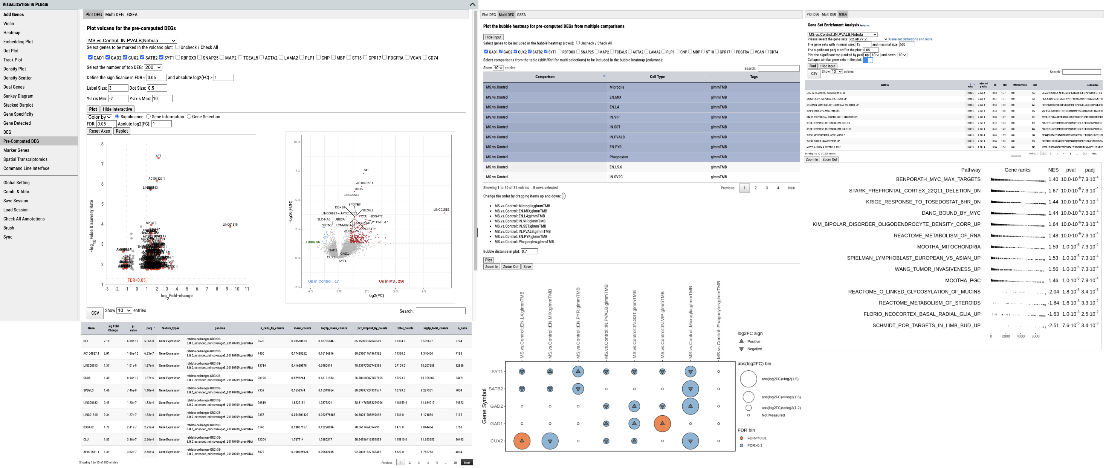
Choose a comparison
Select genes
GSEA results of pre-computed DEG analysis.
DEG analysis for pre-defined annotated groups
Select Comparisons
Significantly up-regulated

Slide 17
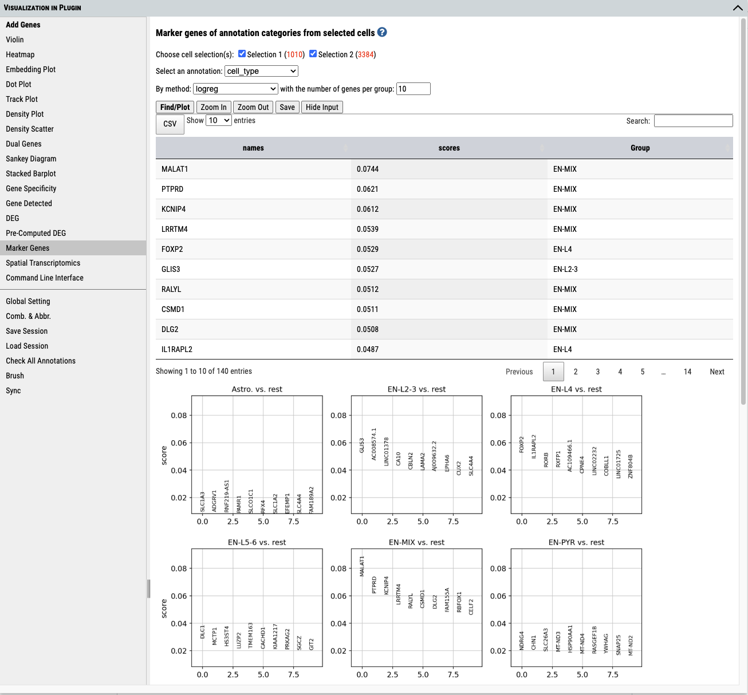
1.Select group(s) of cells for plotting.
2.Select annotation categories for marker gene
3. Select algorithm for detecting marker gene
Marker gene output table
Marker gene score plot by each annotation category

Slide 18
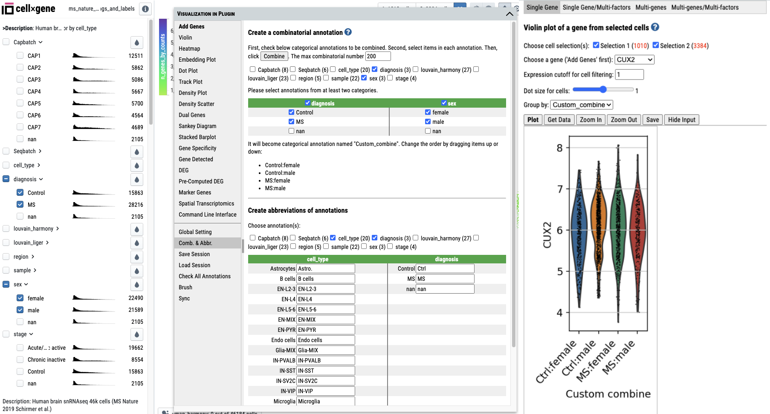
Uncheck all the annotations and only select diagnosis and sex as a new combination.
Select diagnosis and sex as a new combination.
New combination annotation is created and can be used in other tools.
Choose categories desired for renaming.
Violin plot
Rename Control as Ctrl
New combination annotation and user-defined abbreviation is used.

Slide 19
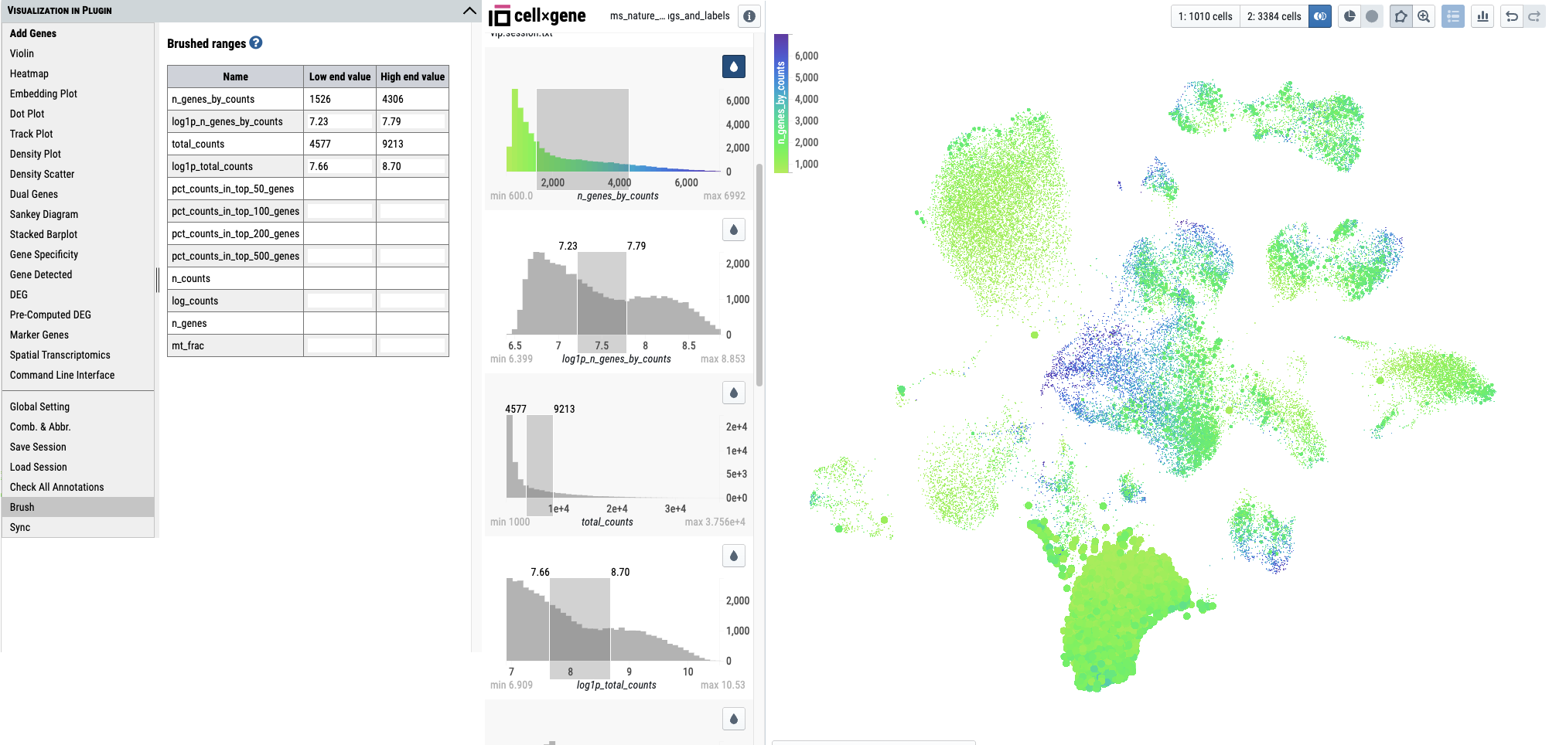
Use color scale to help visualizing the brushed subset in embedding plot
Brush the histogram by dragging cursor.
Save or load a session file
Check all categorical boxes of annotations
List values of brushed ranges on histograms

Slide 20
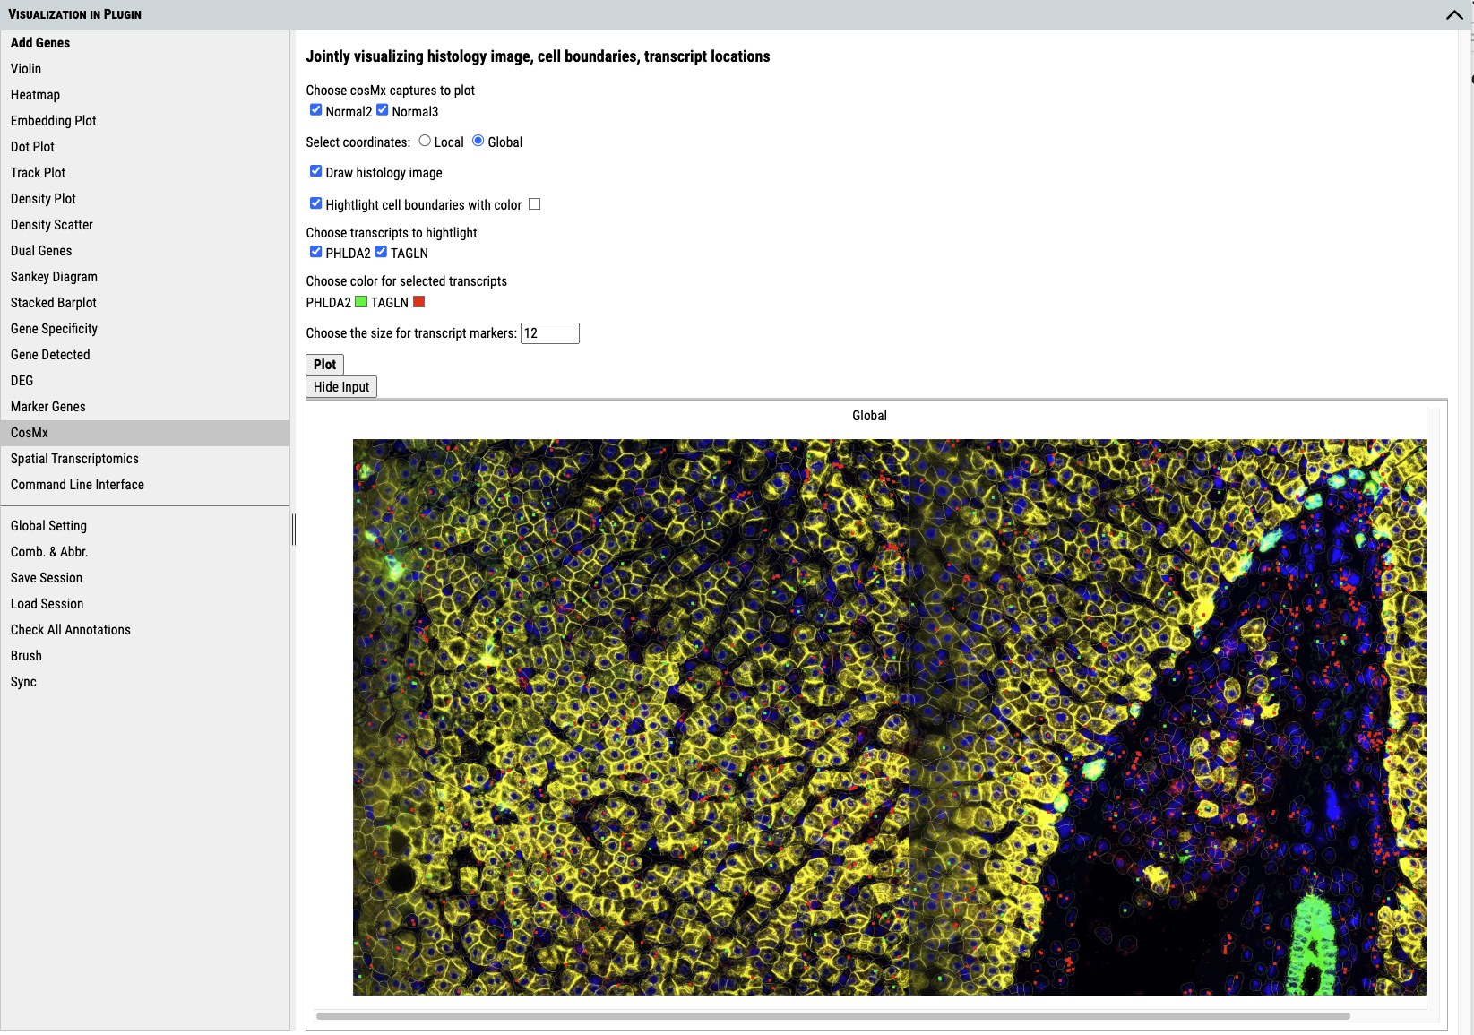

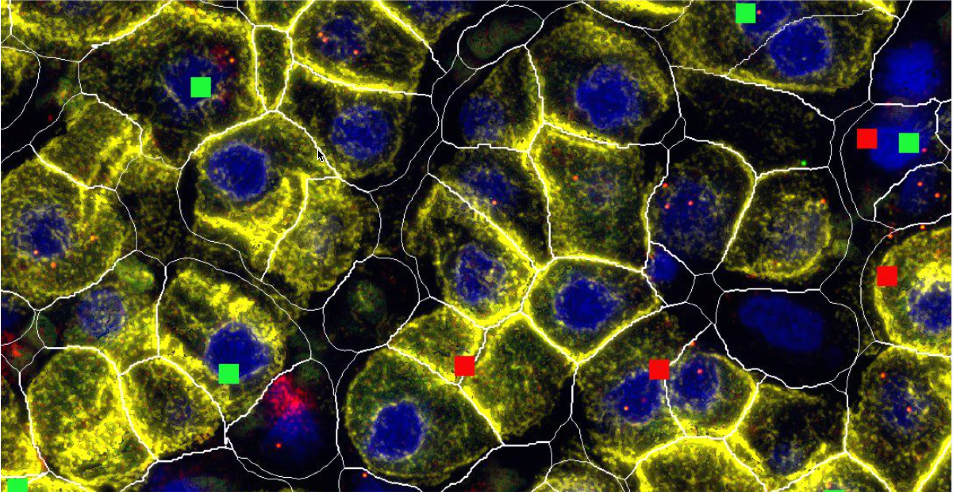
1. Add genes
2. Select captures
3. Select coordinates. “Local” shows captures up and down; “Global” shows captures side by side.
4. Set display preferences
5. Click to plot. It may take a few minutes.
Expression spots of the selected genes
Move the mouse to zoom in on the area.

